Slide 1
Meme Stocks and Market Dynamics: Studying the Influence of r/wallstreetbets on the Stock Market
Christopher Sagayaraj
2202631

Slide 2
Table of contents
01. Introduction
02. Literature
03. Objectives
04. Methodology
05. Analysis
06. Conclusions
Discuss the overall question this paper is trying to answer
Learn about the various literature covered.
Talk about why the models are chosen for this paper.
We can see the how the models interact with each other
Analysis of the data collected and results
Overview of the paper.

Slide 3
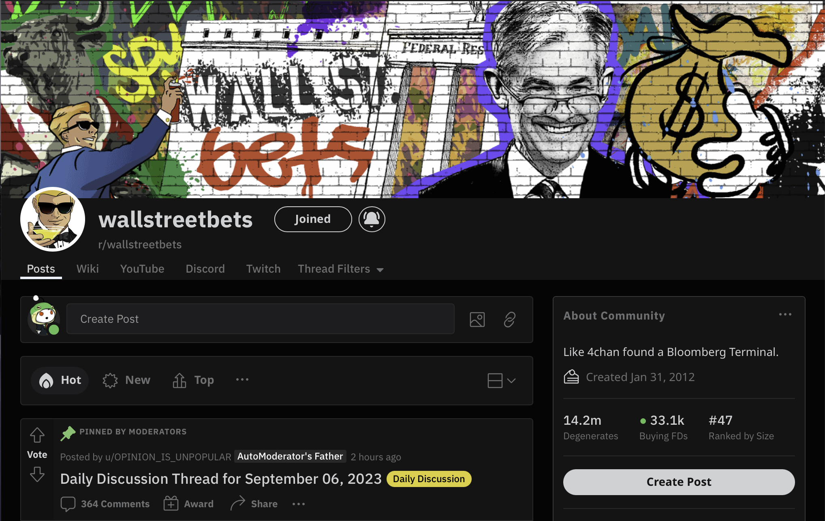

Abstract
This study investigates how the community r/wallstreetbets on Reddit influences the stock market. This a very infamous community within the investor pool in United States.
Members of the US Congress investigated members of this community for market manipulation.
A movie named ‘Dumb Money’ is set to release in theaters on 18th September, which documents the peak of this community.
Source: reddit.com/r/wallstreetbets

Slide 4
Purpose statement
The sentiments of the is then captured with FinBERT, RoBERTa, VADER, and GPT-3.
The scores with the market data including Open, High, Low, Close, and Volume (OHLCV) are combined and used as inputs for ML models
LSTM and CNN are chosen to perform learning on the text and market data to predict the bi-directional movement of market returns.

Slide 5
—Burton G. Malkiel
“But news is by definition unpredictable, and, thus, resulting price changes must be unpredictable and random.”
Notes:
In regards to Efficient Market hypothesis: argued that :
It is argued that any patterns or irrationalities in the pricing of particular stocks found will not continue and won't provide investors a way to generate exceptional profits.
There won't be any $100 notes sitting around the world's stock markets for very long.

Slide 6
Current situation & problems
Situation
Problems
With the nature of r/wallstreetbets, many retail investors follow the financial advice in the community.
Can we utilise the real-time data to determine whether we could be engaged in systematic stock market trading.
Stock prices need to take into account the sentiments of wider society showcased in social media.
No literature covers the current state of r/wallstreetbets and how unsupervised ML can classify live sentiments
Notes:
For example: Elon Musk of Tesla very influential within the stock market and thus any information from the company or Elon itself then prices will move drastically.
Observed a lot of put calls on TSLA stocks.

Slide 7
Literature review
Zou and Herremans (2022).
A multimodal model with Twitter FinBERT embeddings for extreme price movement prediction of Bitcoin
Studied how Twitter data with FinBERT can be used with CNN to predict the
Coppens (2022).
THE CORRELATION BETWEEN REDDIT SENTIMENT AND THE STRONGEST- AND WEAKEST PERFORMING CRYPTOCURRENCIES OF 2021
Found the correlation between Reddit’s cryptocurrency communities.
Carter (2023).
Stock Price Prediction Using Sentiment Analysis and LSTM.
Studies the effects of r/wallstreetbets with a labelled dataset using Flair and LSTM.

Slide 8
Literature review – Sentiment analysis
Liu et al. (2020).
FinBERT: A Pre-trained Financial Language Representation Model for Financial Text Mining
Trained BERT on financial text to create the first domain specific model.
Liu et al. (2019).
RoBERTa: A Robustly Optimized BERT Pretraining Approach.
Develops a new BERT system which is trained for longer and can be easily fine tuned to any domain.
Hutto and Gilbert (2014).
VADER: A Parsimonious Rule-based Model for Sentiment Analysis of Social Media Text
Created a gold standard sentiment lexicon with human annotators for social media text.
Brown et al. (2020).
Language Models are Few-Shot Learners
Paper lays down the technical details for the creation of GPT-3.

Slide 9
Study objectives
Step 1
Data Collection
Step 2
Stock Price Collection
Step 3
Unsupervised Sentiment Analysis
Step 4
Neural Network Parameters
Step 5
Analysis and Results
Notes:
Unsupervised learning: Unlabelled data. FinBERT, RoBERTa uses pipeline from Hugging face. VADER is utilized from NLTK. And GPT-3 was paid for usage using unlabelled data.

Slide 10
Data
Understand the data collected.

Slide 11
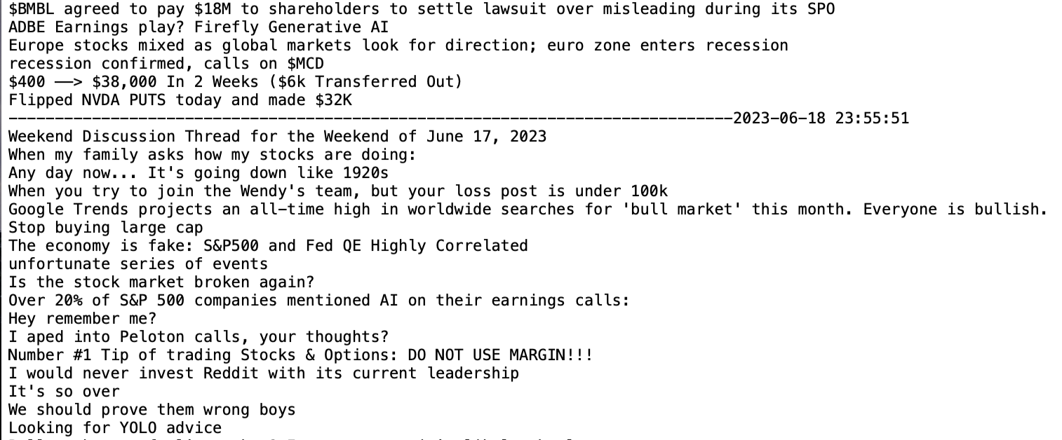
About the data - text
This is how the initial data is first collected in a txt file with the date indicating when it was collected. Each new line is a different headline and the sentiment is collected for every sentence.

Slide 12
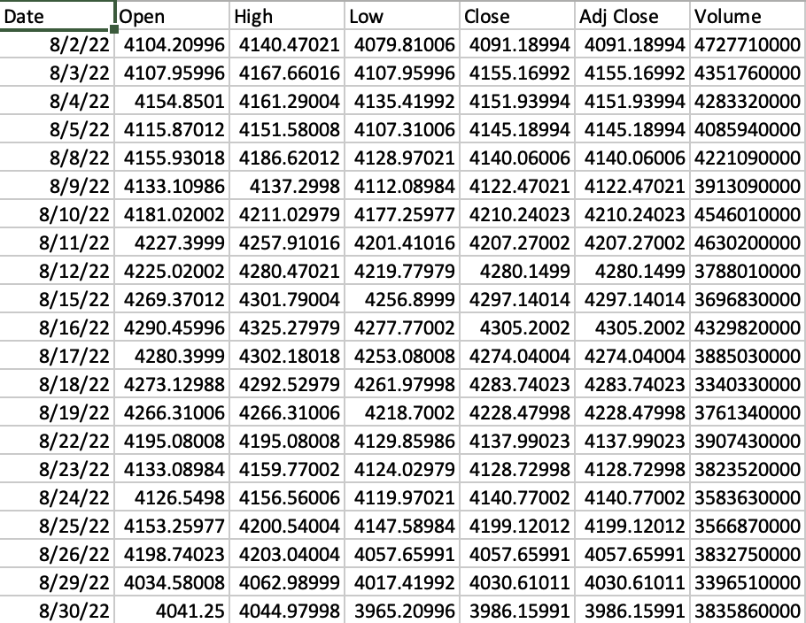
About the data
This is the market data collected for S&P and all other tickers.
It includes Open, High, Low, Close, and Volume (OHLCV). The adjusted close is not used for this study.

Slide 13
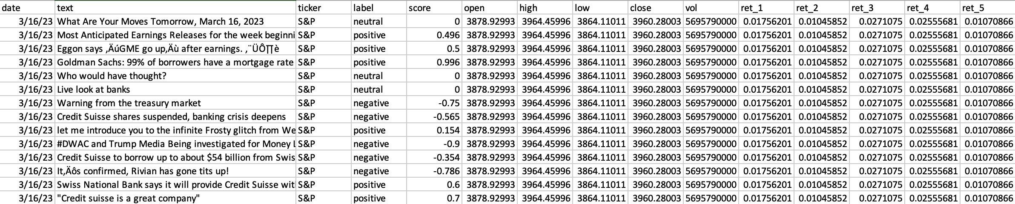
About the data
This is the final data collected and used as inputs for CNN and LSTM. The text, ticker, label, score, open, high, low, close and vol columns are used as inputs. The output column is determined by which day the return is being predicted.

Slide 14
Analysis
Analyze the data collected and see the sentiment scores from the various models

Slide 15
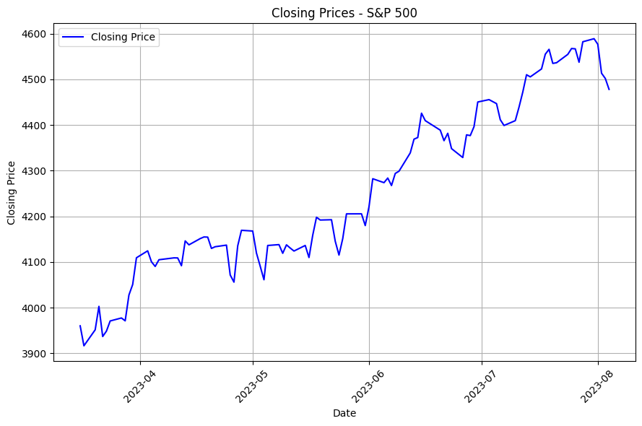
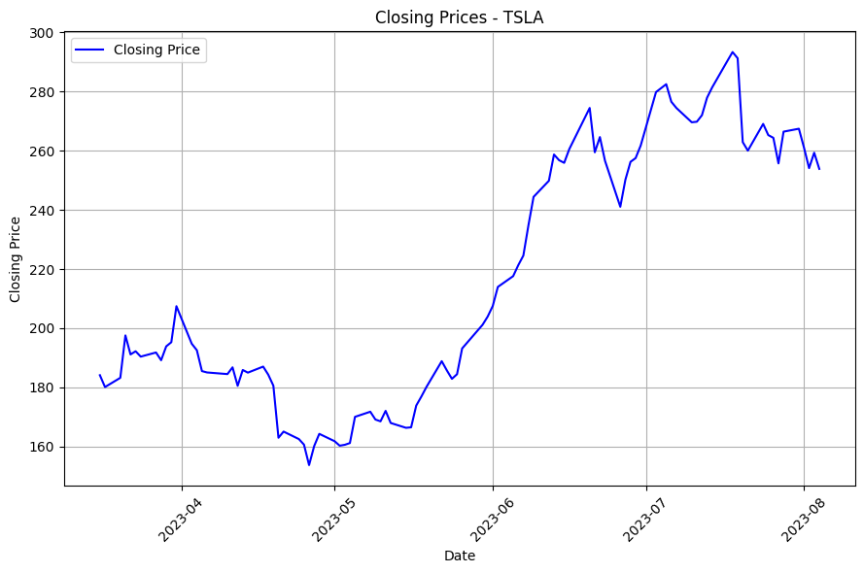
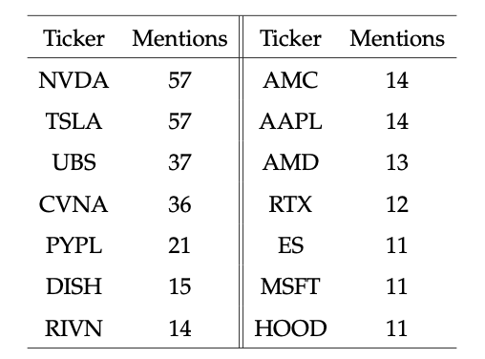
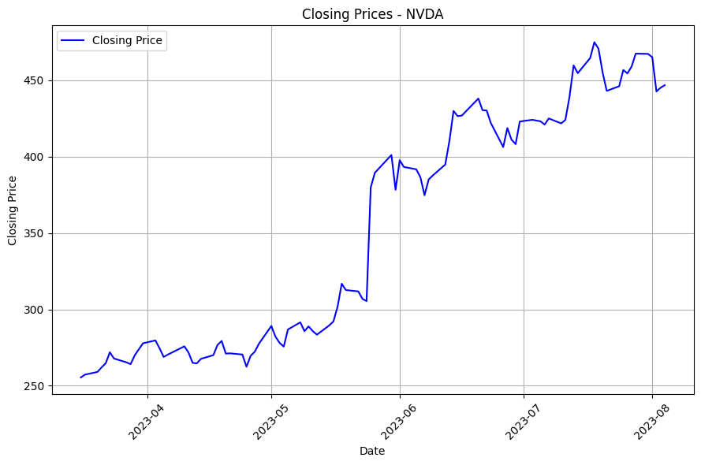
Stocks
Stocks with more than 10 mentions

Slide 16
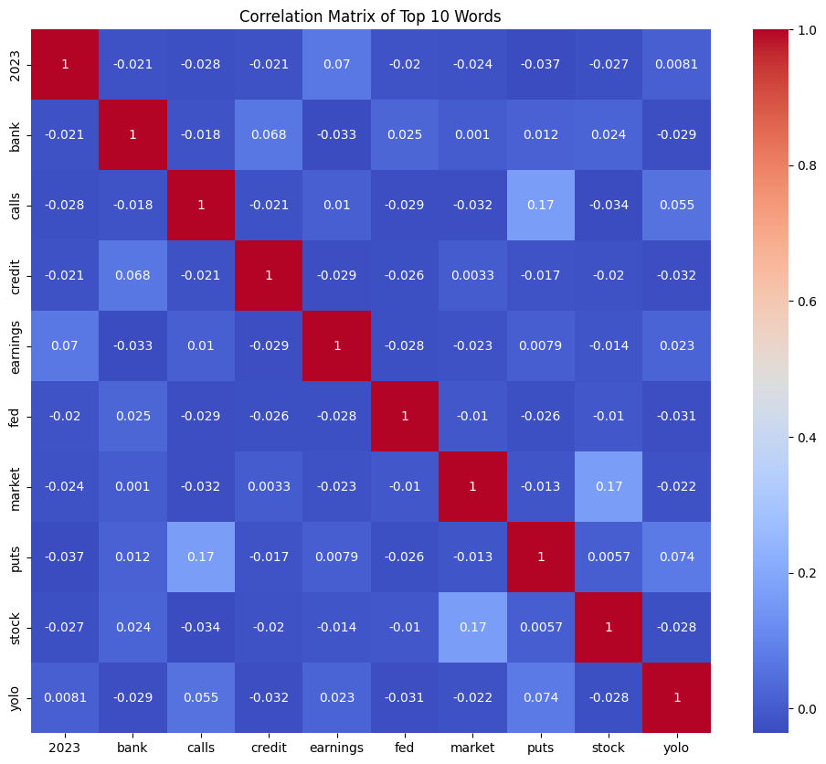
Text

Slide 17
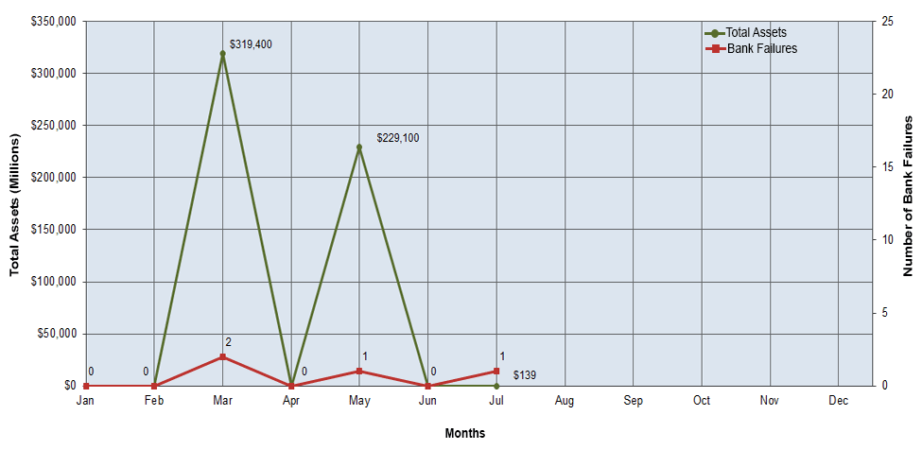
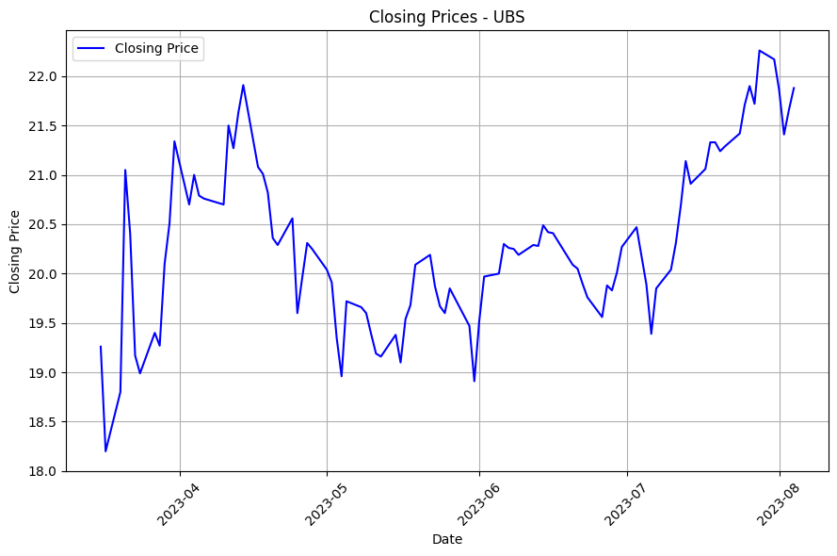
Banks

Slide 18
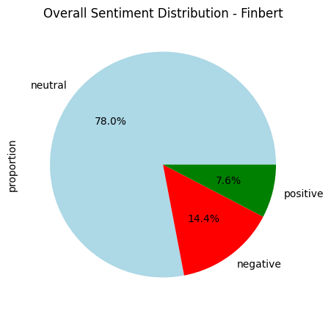
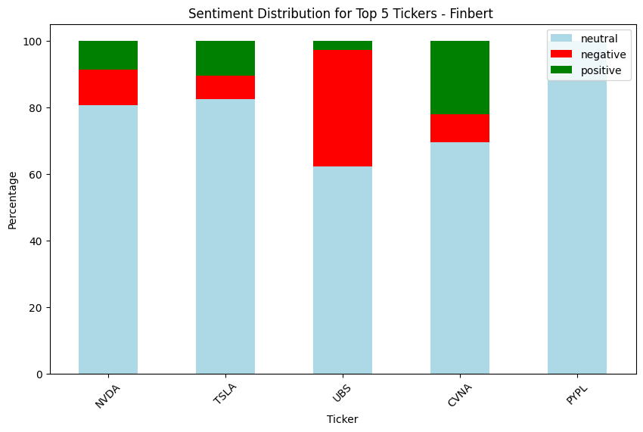
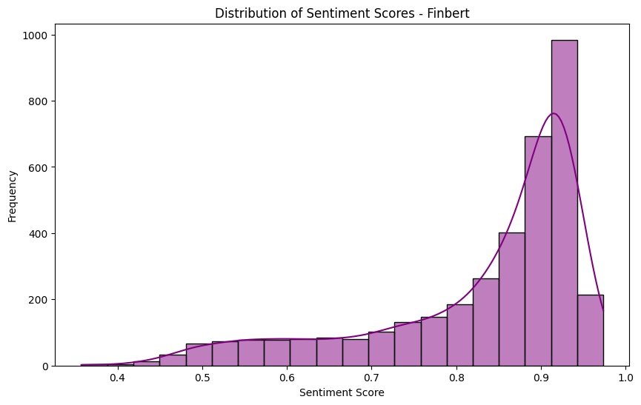
FinBERT scores

Slide 19
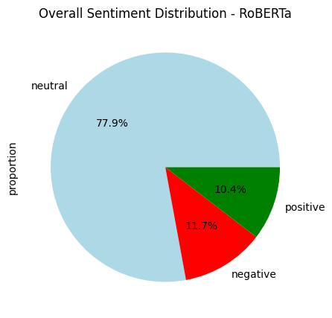
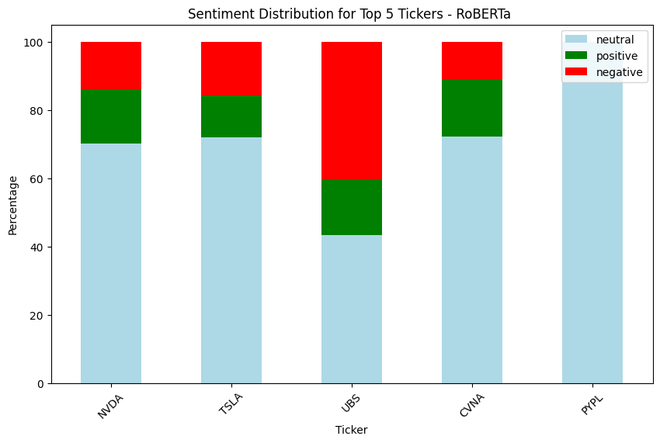
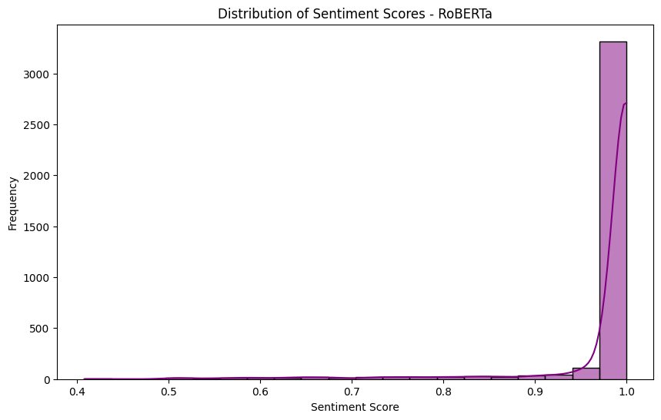
RoBERTa scores

Slide 20
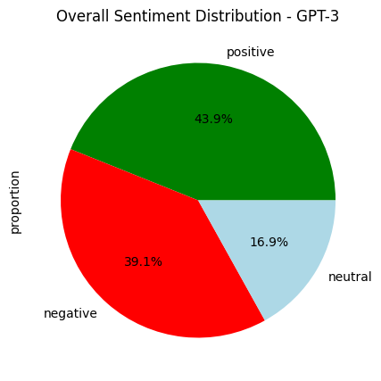
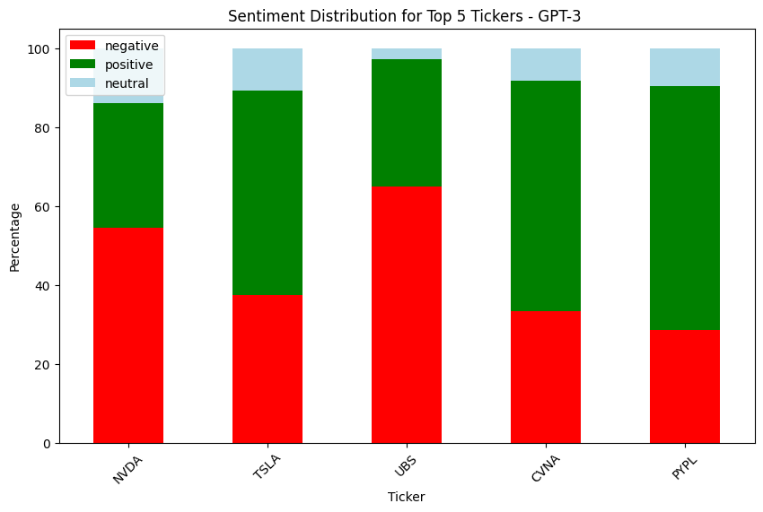
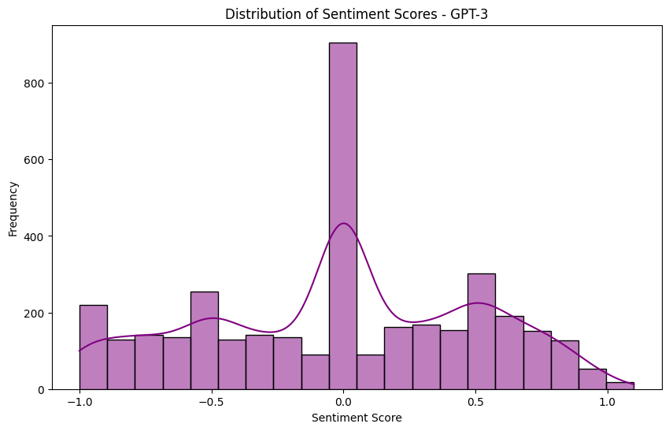
GPT-3 scores
“Analyze the given text and classify it into: negative, or positive. Also, provide a sentiment score within the range of -1 to 1. Score values must be calculated with high precision with up to three decimal places. Your response format should be: sentiment, score e.g., (’negative, -0.145’). “

Slide 21
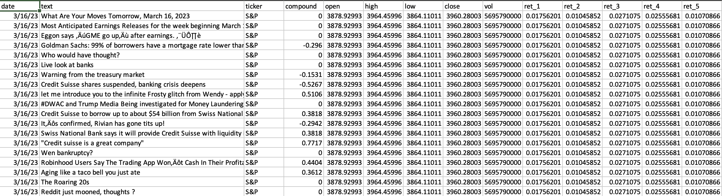
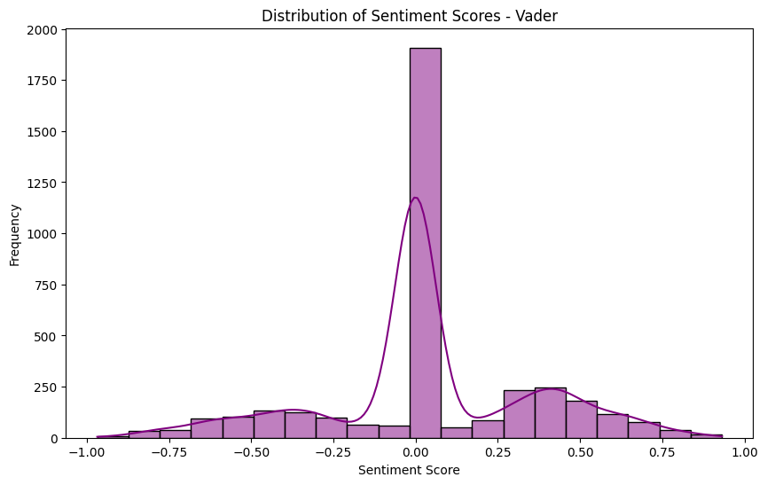
VADER

Slide 22
Model Architecture
Understand how all the models connect with each other.

Slide 23
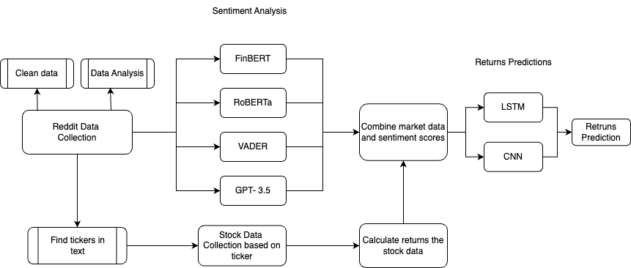
Architecture

Slide 24
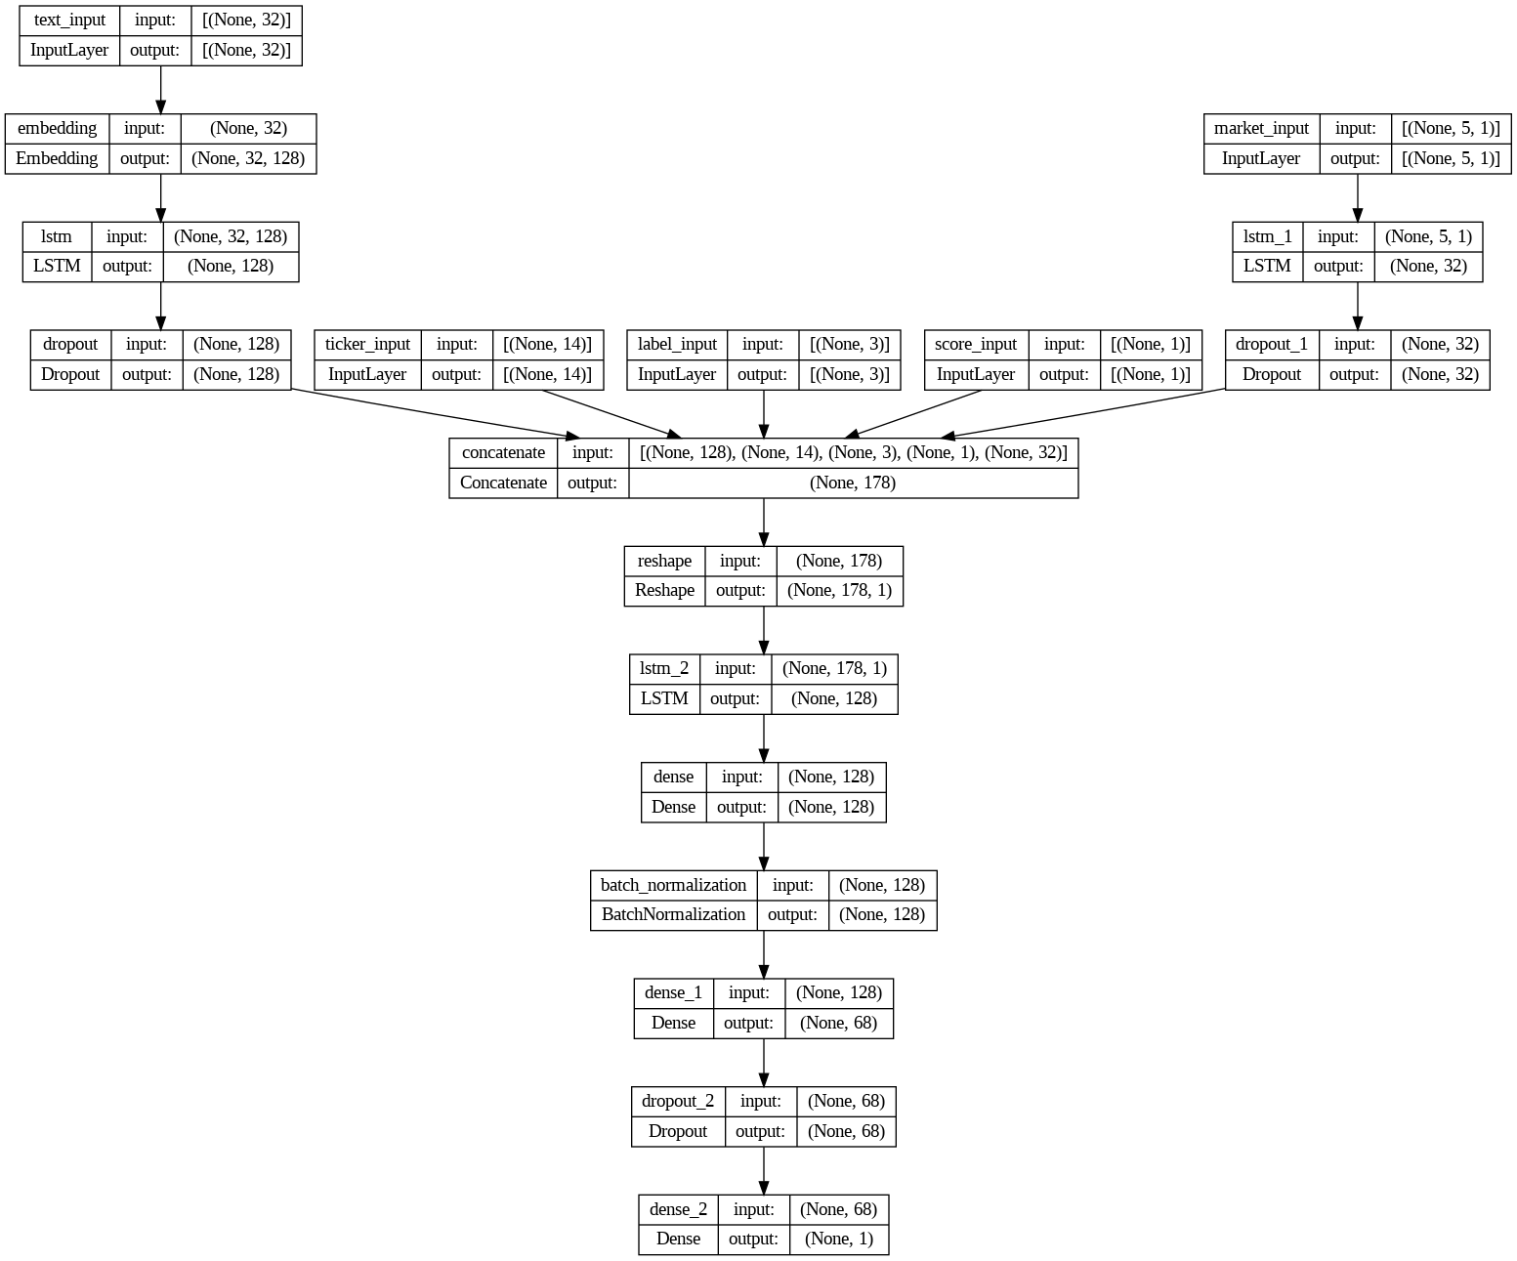
LSTM

Slide 25
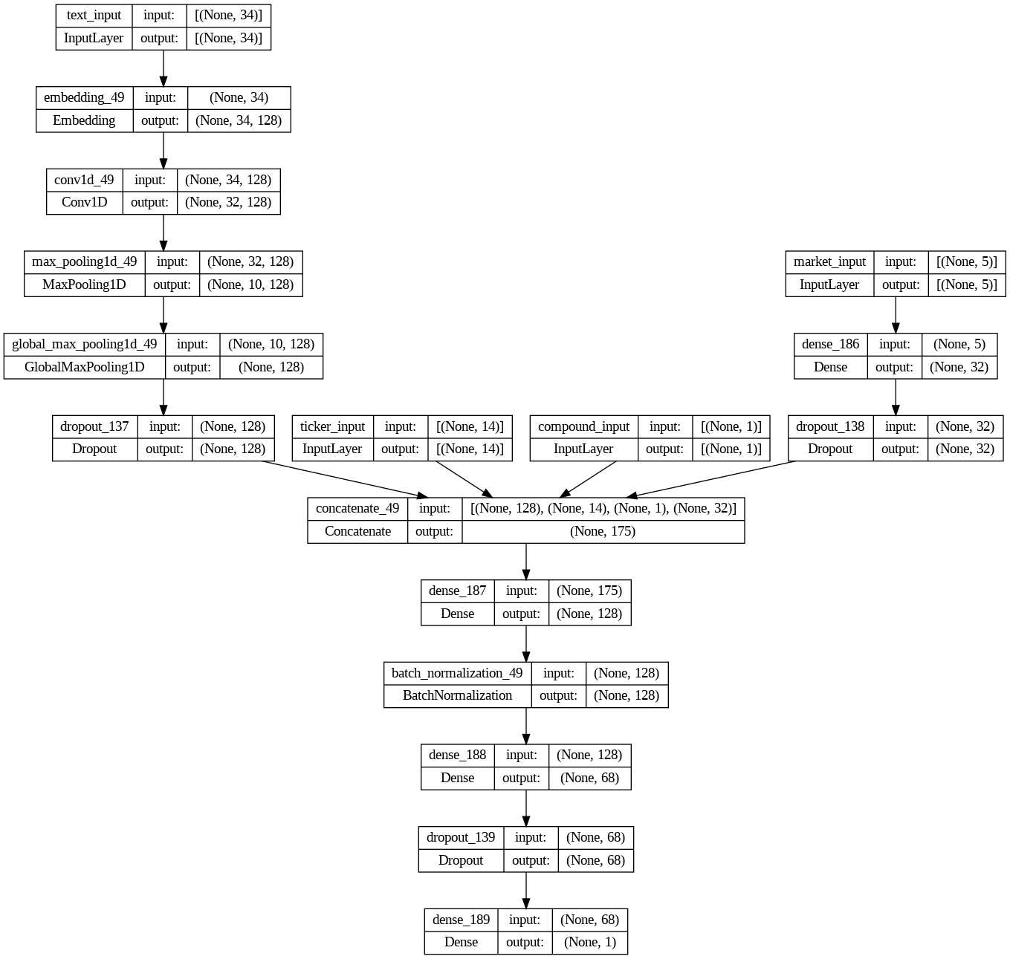
CNN

Slide 26
Results
Analyze the results captured from this model

Slide 27
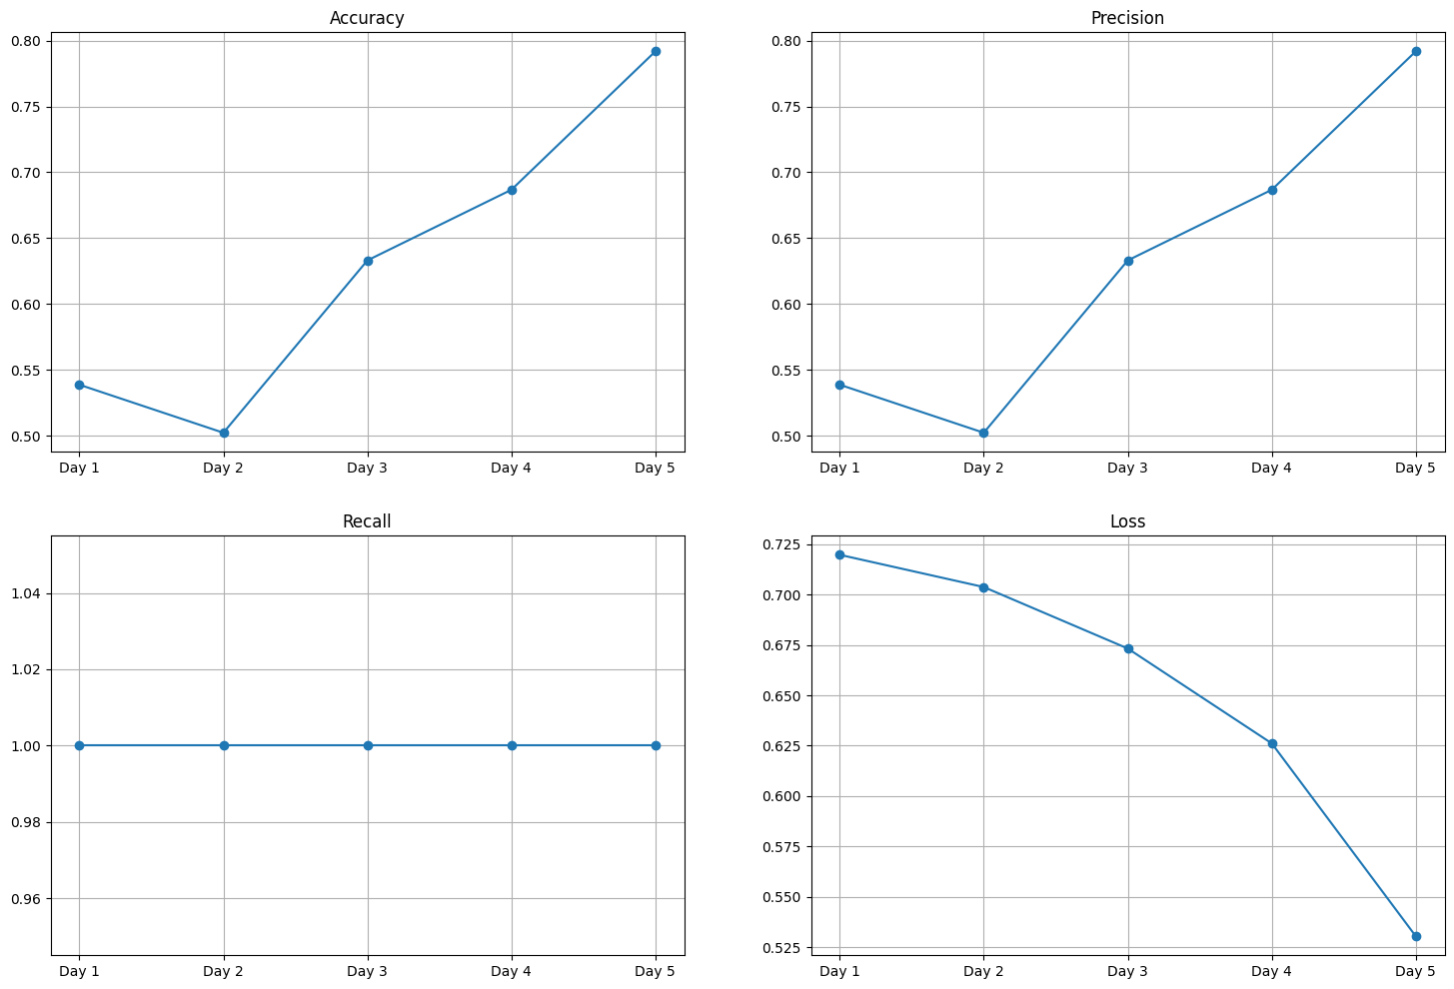
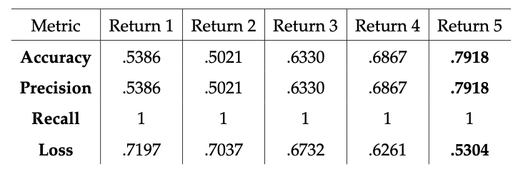
FinBERT - LSTM

Slide 28
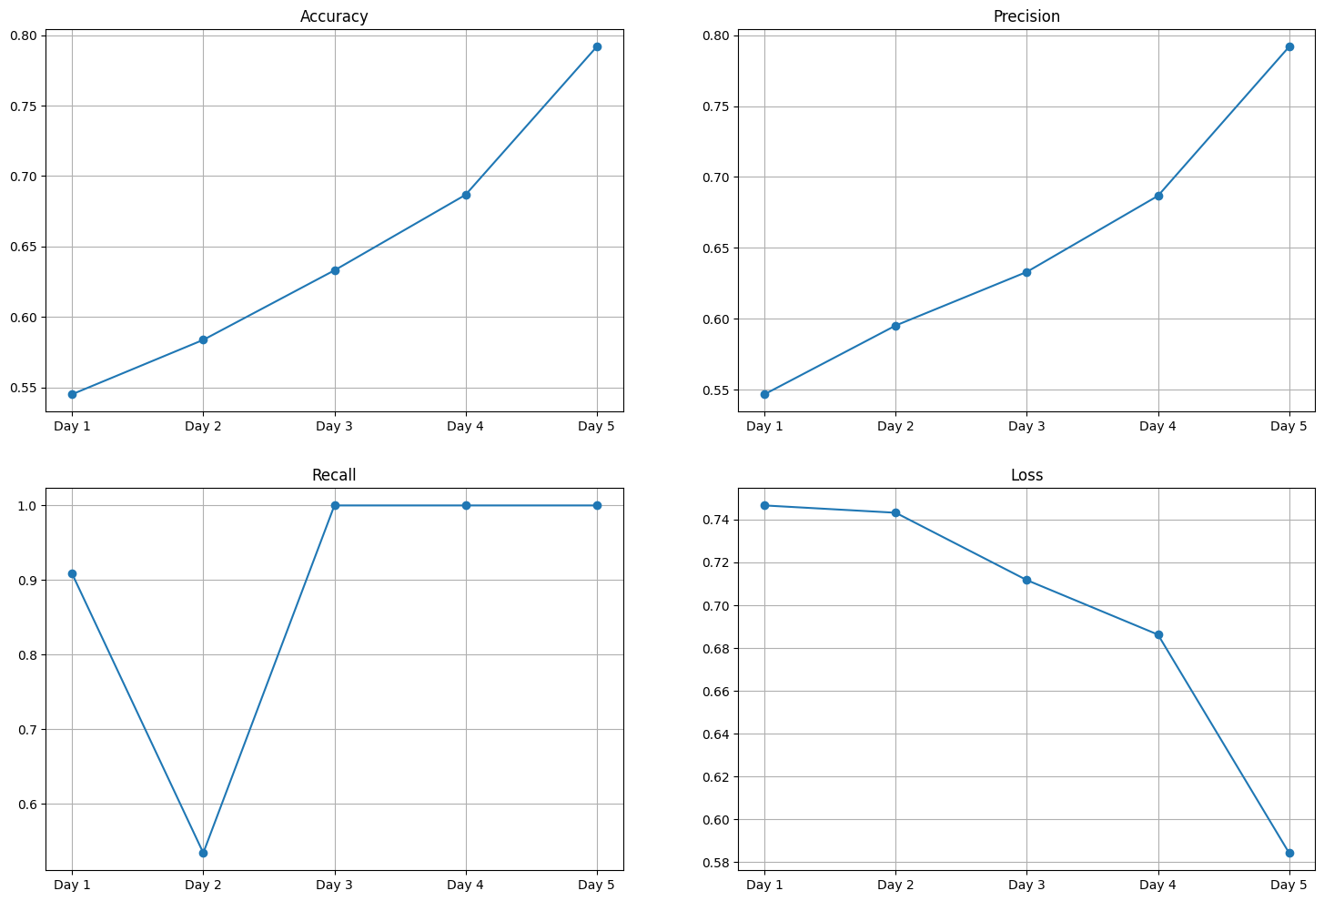
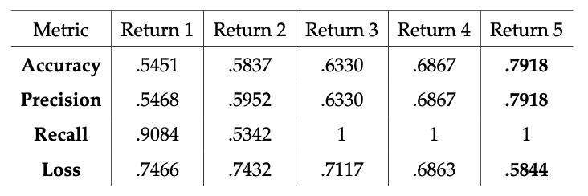
RoBERTa - CNN

Slide 29
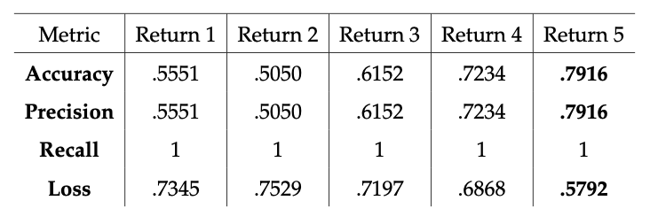
GPT-3 - CNN

Slide 30
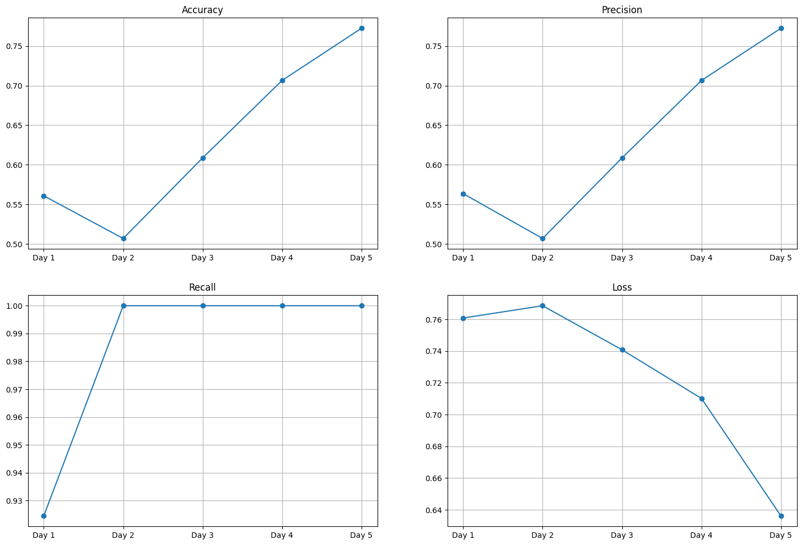
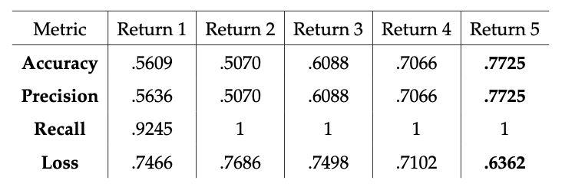
VADER - LSTM

Slide 31
Result Analysis
The models have a high accuracy of over 75% across all models, but do not provide a clear winner among the sentiment analysis tools.
All these models provide similar scores across the varied sentiment scores, with less than 3% between the highest and lowest scores.
With a very high recall in a classification model, the model predicts positive for most scenarios and thus ends with a high score, and in some instances with a perfect recall.
All models have the highest score on the 5th day of return. Work can be conducted to study longer periods of return.

Slide 32
Conclusion

Slide 33
Conclusion
A total of 3,714 headlines were collected from the r/wallstreetbets from March 2023 - August 2023. Four models were selected - FinBERT, RoBERTa, VADER, and GPT-3.
The returns for the stock are calculated for up to 5 days to observe if the headlines have any impact on the market in the upcoming week. Two neural network models - LSTM and CNN were used to predict the bi-directional movement of the returns.
The combination of FinBERT and LSTM provided the highest scores resulting in 79.18% accuracy when predicting the return of the fifth day.
All these models provide a high accuracy score but do not have a significant deviation from each other. This suggests that the sentiment scores from r/wallstreetbets exclusively do not have a strong influence on the market trends.

Slide 34
Thanks
Slidesgo 2022
Please find the work conducted for the paper on GitHub: github.com/Christopher-jason/cjs-dissertation
Please keep this slide for attribution

